Slide 1

CSE441 –
INDUSTRY INTERNSHIP PROJECT
Guided By: Amandeep Kaur
Name: Motupalli Mani Sri Sai Varun
Reg No: 11906423
Section: K19SB
Roll No : 71

Slide 2
Create a serverless containerized Nodejs apps on aws ecs Fargate with aws copilot

Slide 3
Agenda
Introduction
Tools used in project
Architecture
Outcome
Steps Involved In Project

Slide 4
Introduction To Project
AWS ECS Fargate is a fully managed container orchestration service that allows you to run containers without the need to manage the underlying infrastructure. AWS Copilot is a CLI tool that simplifies the deployment and operation of containerized applications on AWS.
To get started with deploying a serverless containerized Node.js app on AWS ECS Fargate with AWS Copilot, you can follow these steps:
Create a Dockerfile: Start by creating a Dockerfile for your Node.js app. The Dockerfile should include the necessary dependencies for your app to run.
Build the Docker image: Use the docker build command to build the Docker image for your app.
Create an ECS cluster: Next, you'll need to create an ECS cluster using the AWS Management Console or the AWS CLI. This will be the environment in which your app will run.
Create an ECS service: Once you have your ECS cluster, you'll need to create an ECS service to run your app. This can also be done through the AWS Management Console or the AWS CLI.
Deploy with AWS Copilot: Finally, you can use AWS Copilot to deploy your app to your ECS service. AWS Copilot will handle the creation and management of the necessary AWS resources, such as load balancers and task definitions, and will deploy your app using the Docker image you created in step 2.
With these steps, you can easily deploy a serverless containerized Node.js app on AWS ECS Fargate with AWS Copilot.

Slide 5


Node.js.
Docker
Git hub
VS Code Editor
Aws Services:
Aws Copilot
Aws Ecr
Aws Codecommit
Aws ECS
Tools Used in Project

Slide 6
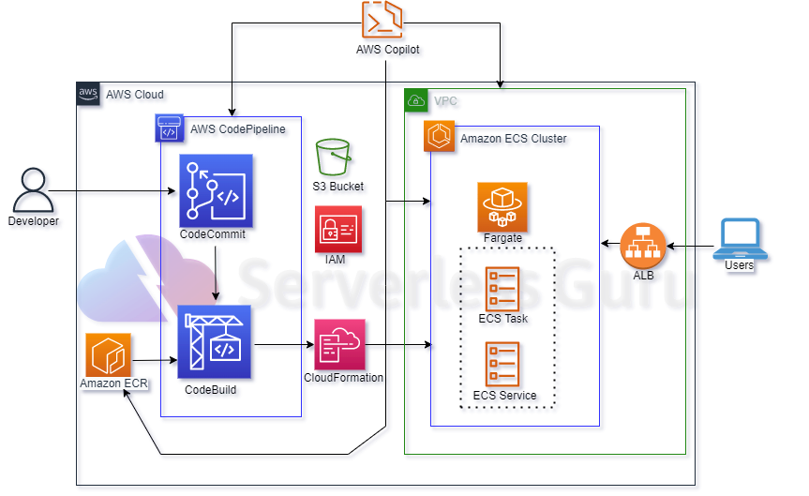
Architecture

Slide 7

Things I learn’t
1. I learn’t How to deploy a containerized applications using Docker on AWS.
How to send containers using AWS Copilot.
Learn Docker and How to containerize a Nodejs application
Creating Dockerfile
Building DockerImage
Running Docker Container
Docker Commands
Create an ECR repository using AWS Copilot and push Docker Image to ECR.
Learn how to clone Git repository to AWS Codecommit
Create a containerized applications and services using AWS

Slide 8
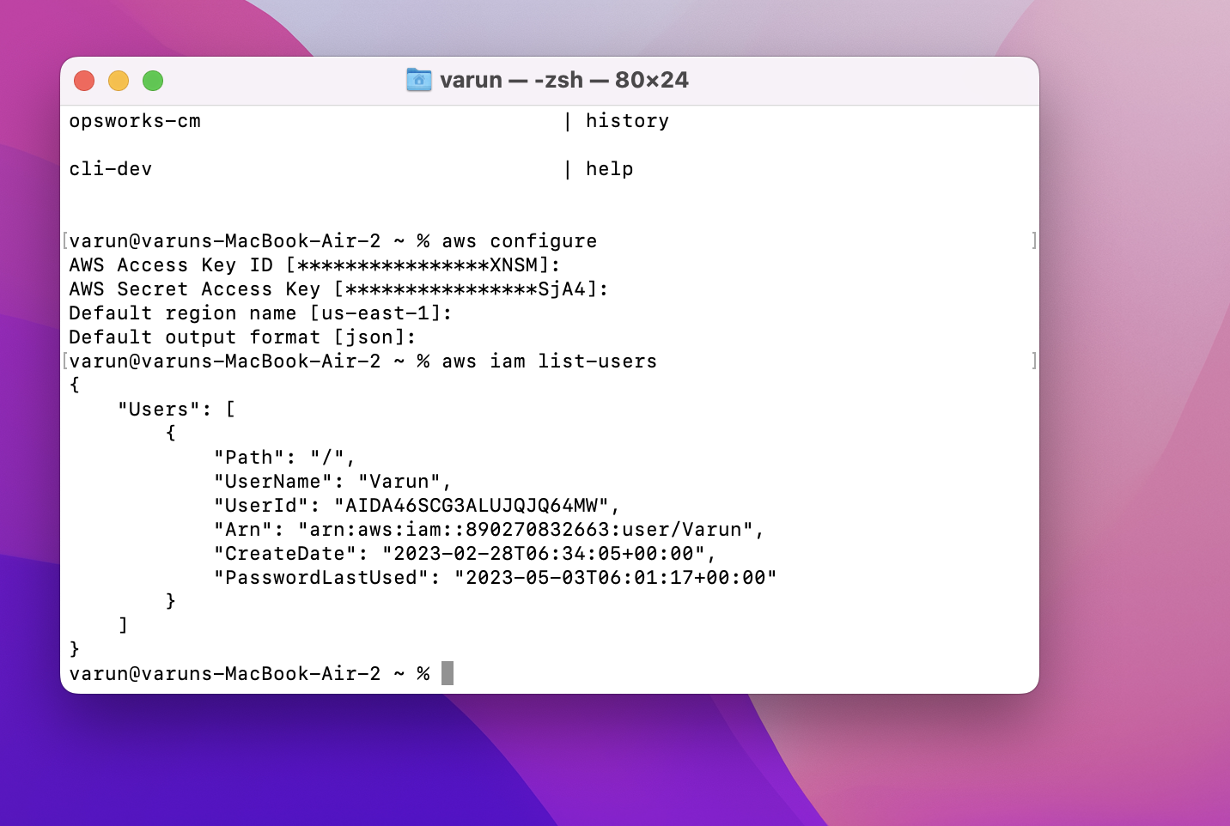
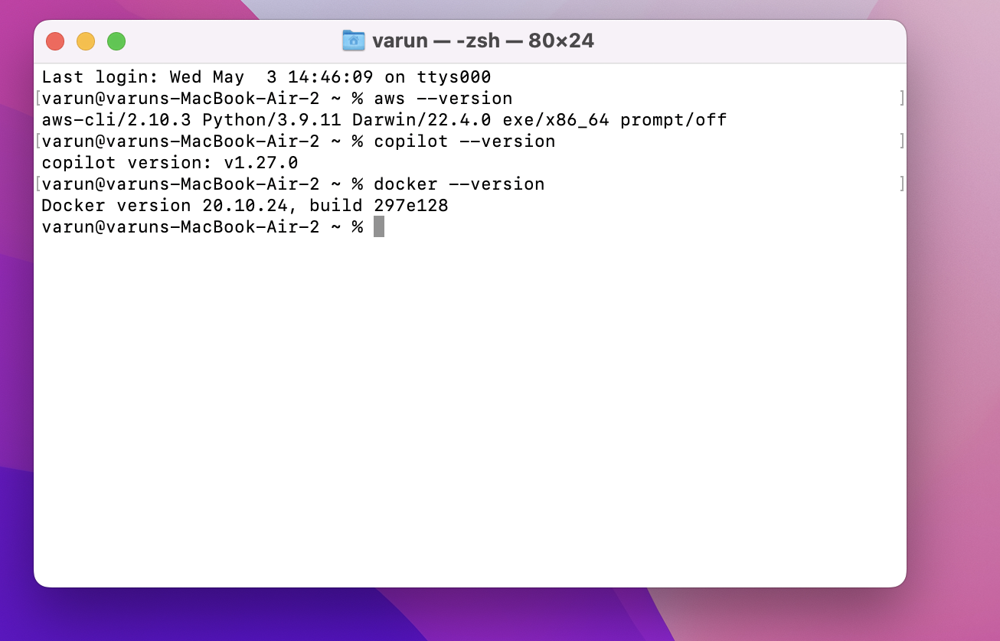
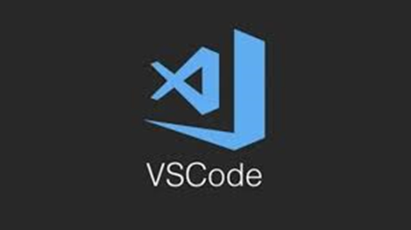
Prerequisites

Slide 9
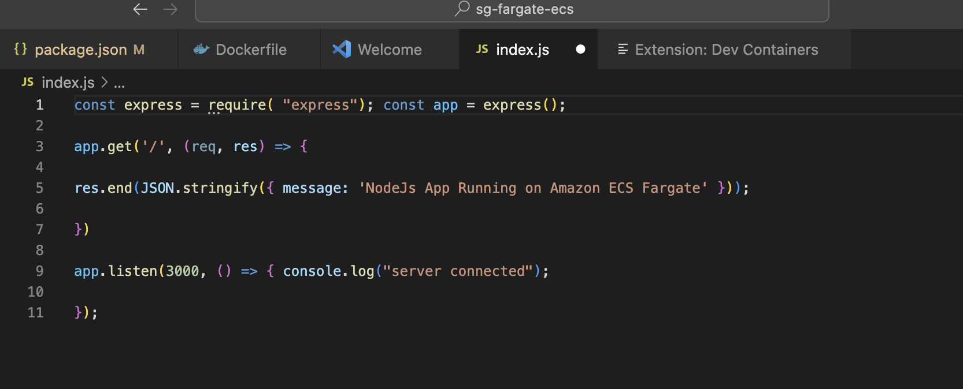

Create a Nodejs app

Slide 10
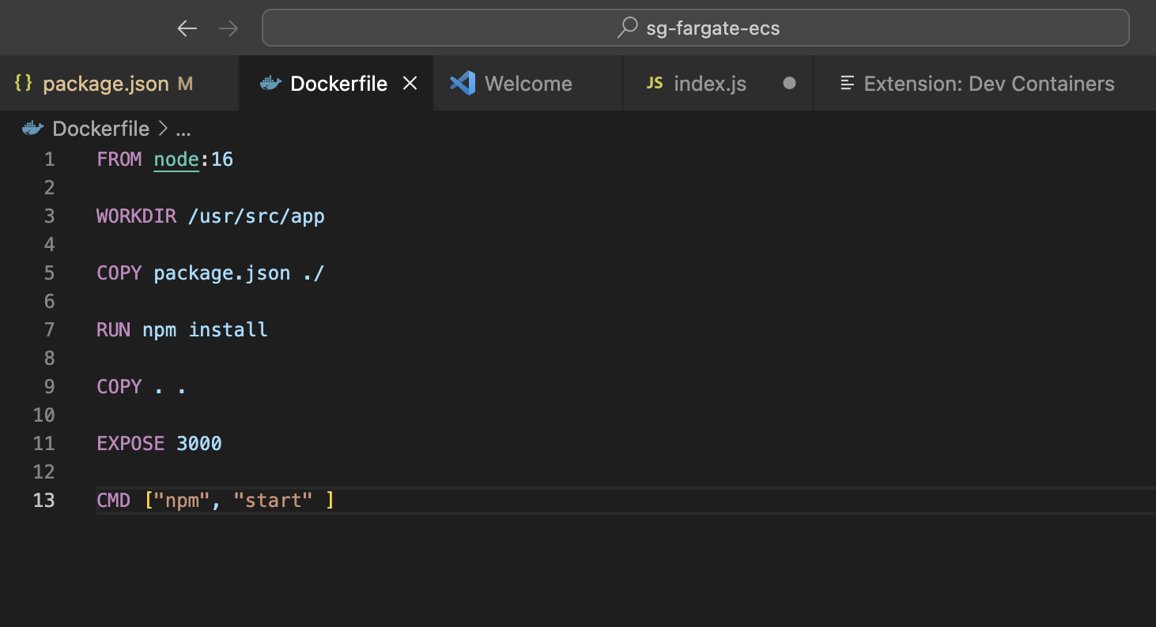
How to containerize the application using Docker
Create a Docker file so that we can deploy this application in the form of a container.

Slide 11
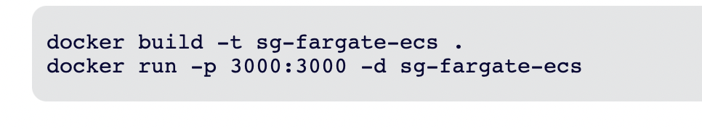
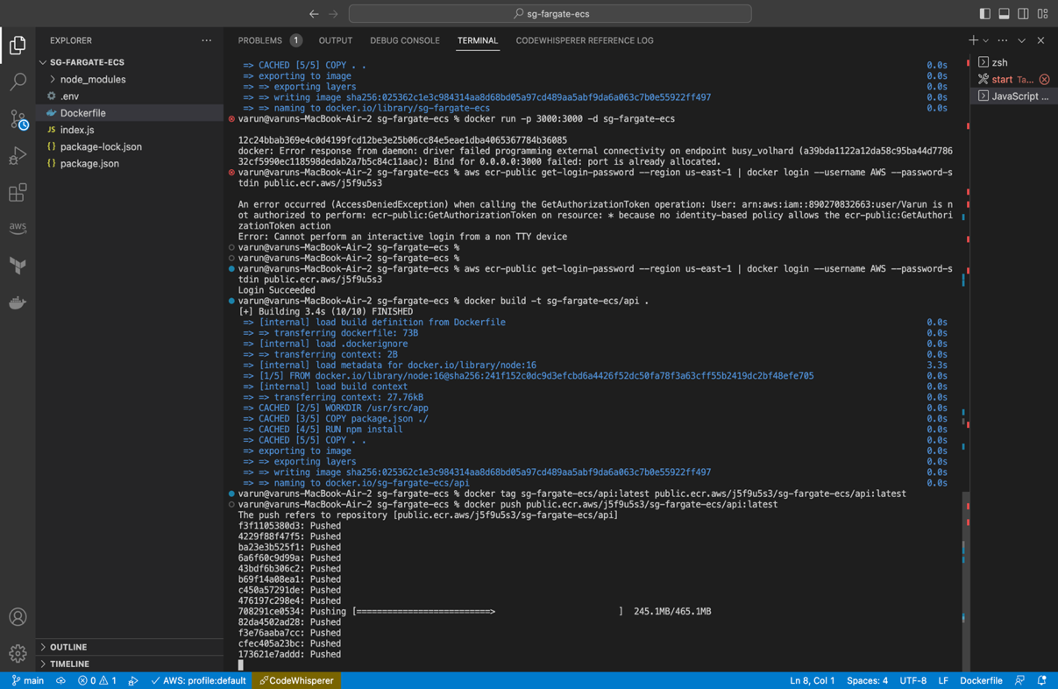
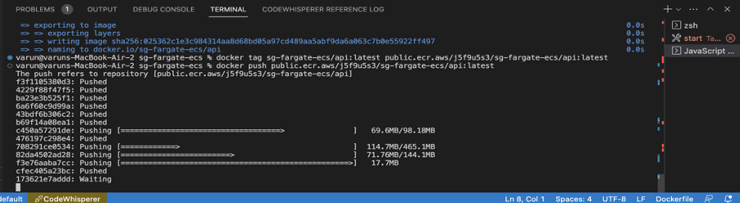
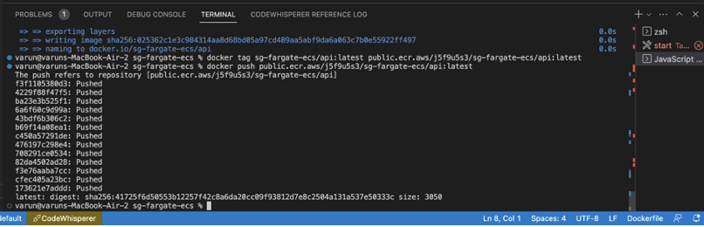
Create a Docker file so that we can deploy this application in the form of a container

Slide 12
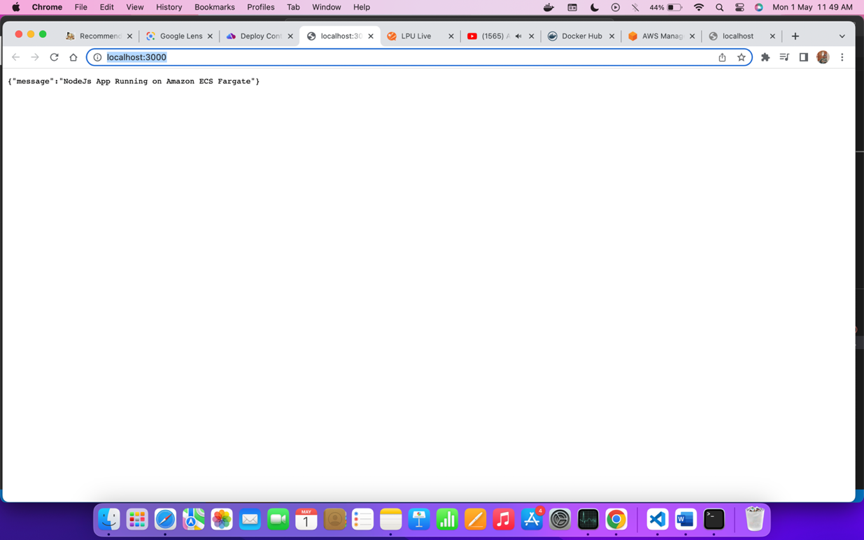
Now open the Browser and type http://localhost:3000, and it returns the below message

Slide 13
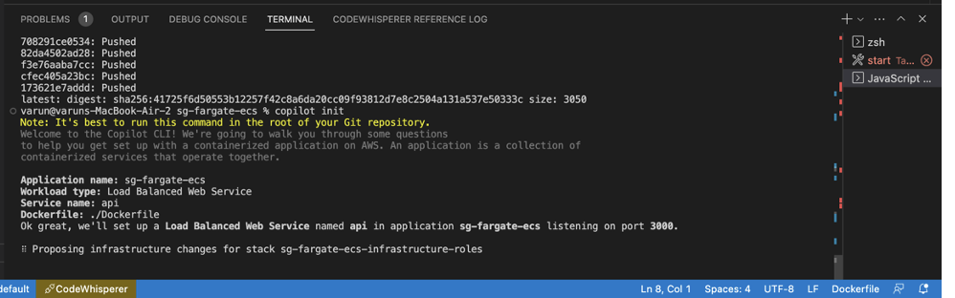
Deploy to Amazon ECS Fargate with AWS Copilot
To deploy the docker file to AWS ECS we need to use the following command
Copilot init

Slide 14
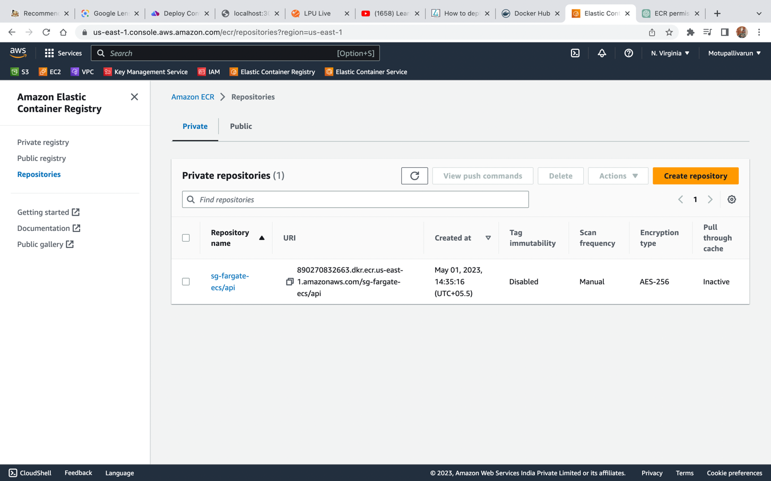
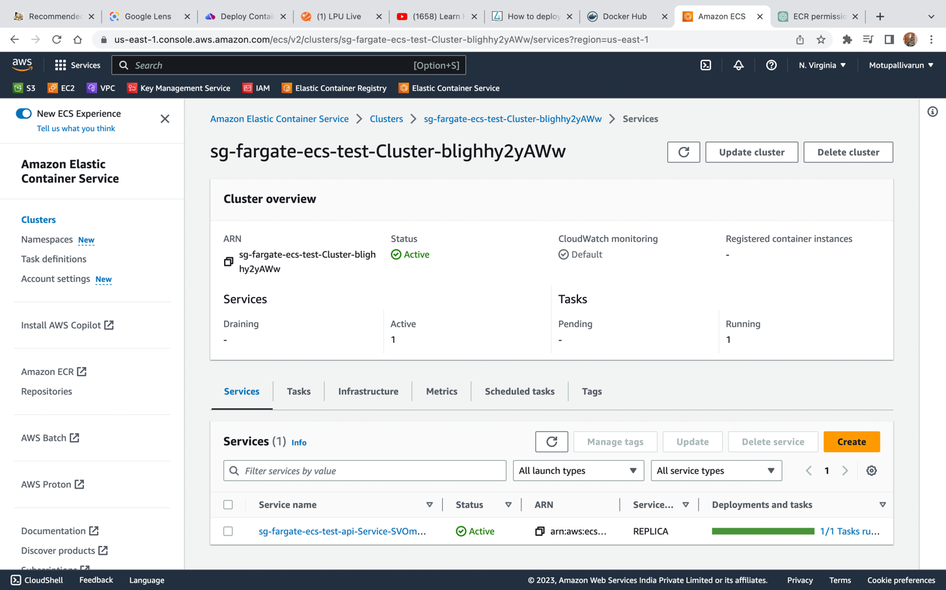

Slide 15
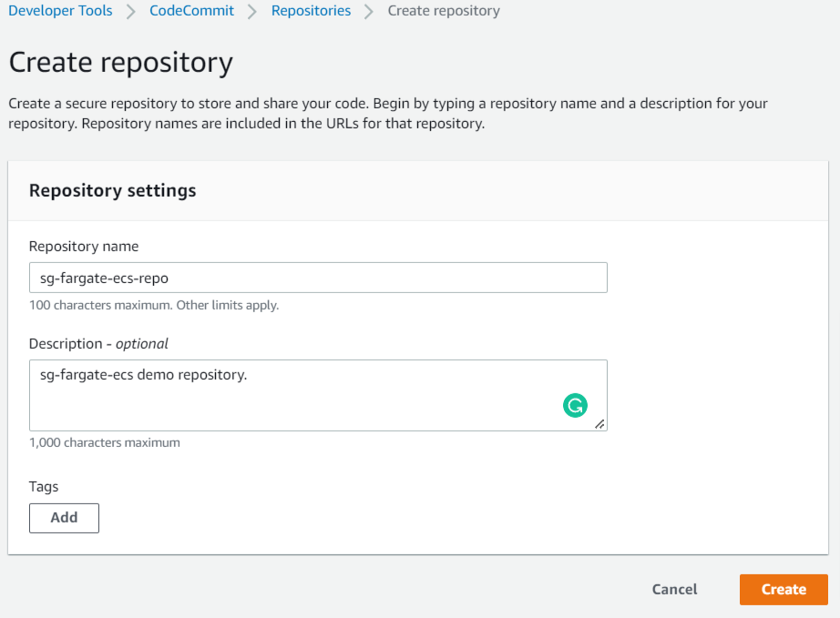
Create aws codecommit repositry
Services → Developer Tools → CodeCommit → Repositories → Create repository

Slide 16
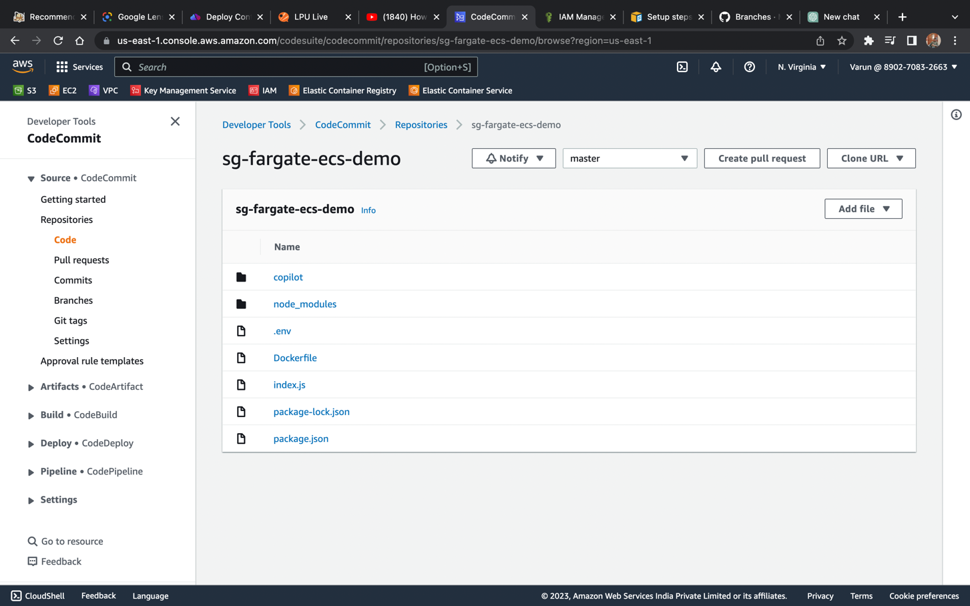
Add AWS CodeCommit Repository as remote origin in a local git repository

Slide 17
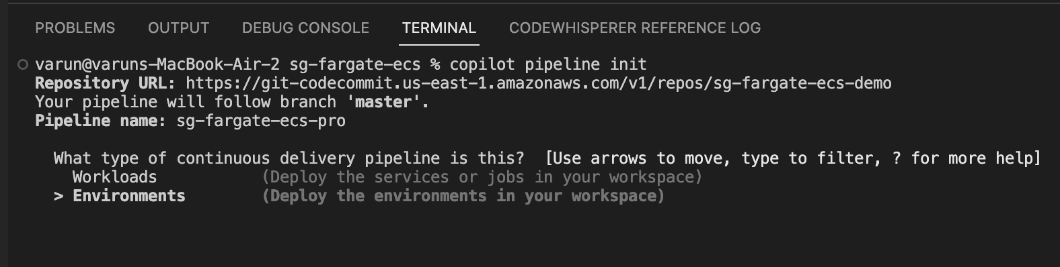
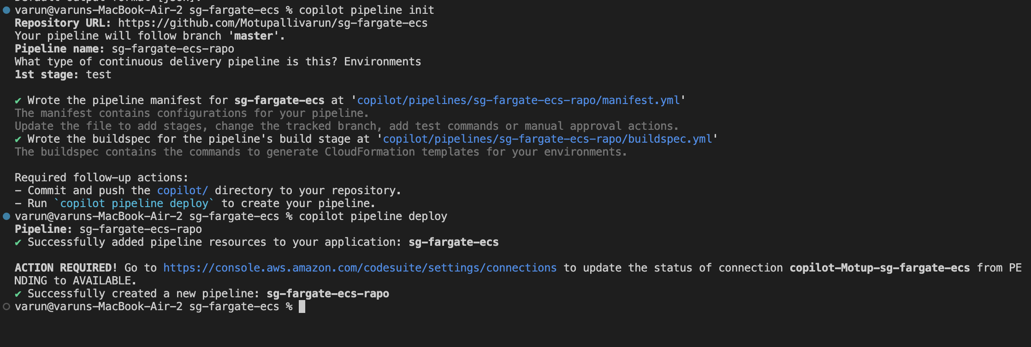
AWS CI/CD Pipeline Workflow with AWS Copilot

Slide 18
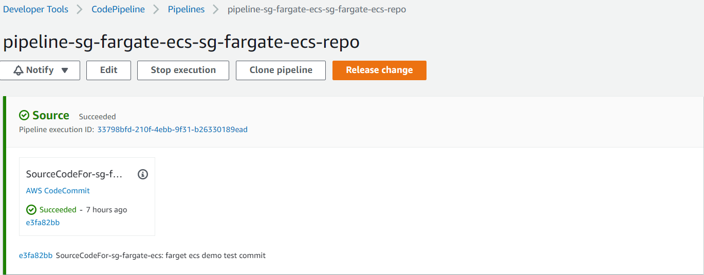
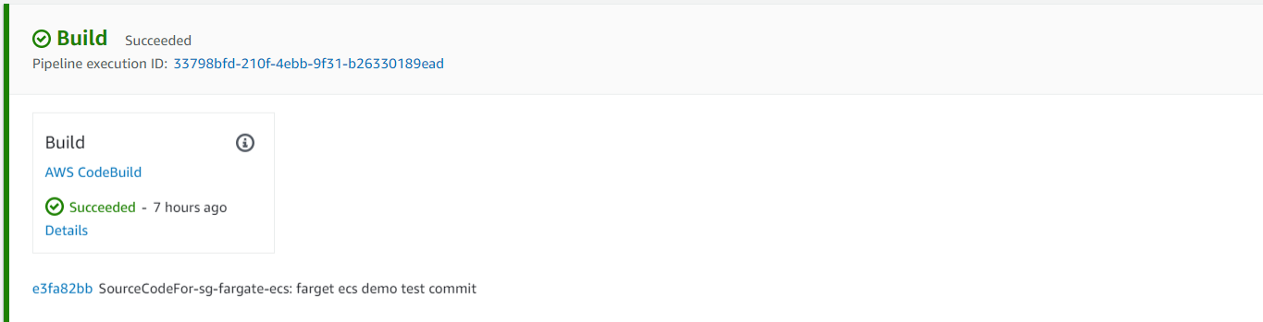
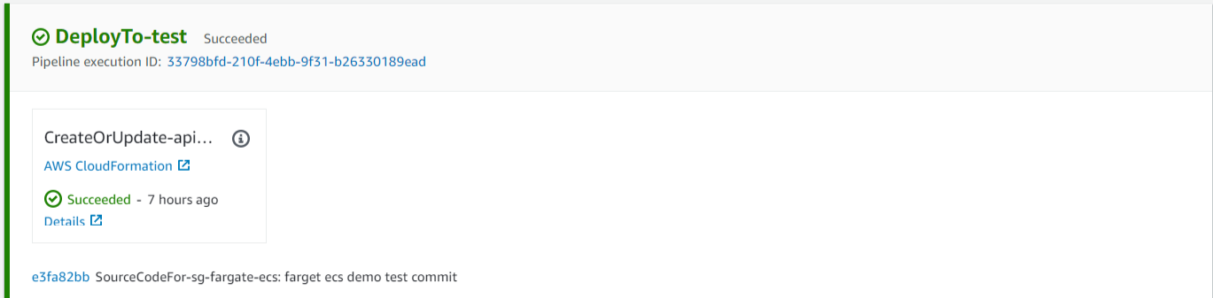
Aws Codepipeline

Slide 19

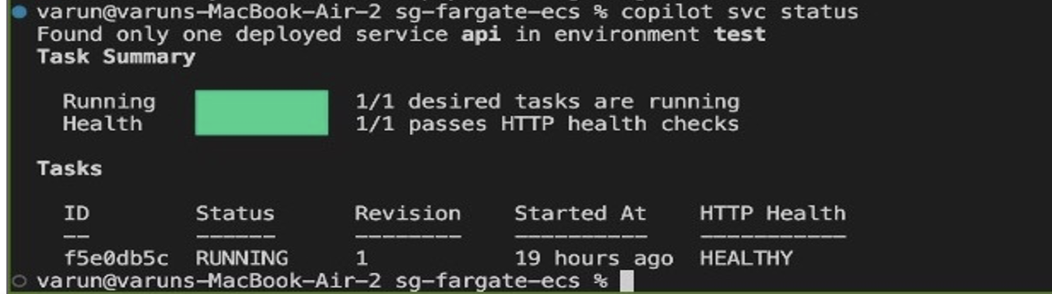
Check the container deployment status
We can check the deployment status by the following command

Slide 20
Thank You

Slide 21

Thank you

